Slide 1
Bayesian Network Modelling and
Probabilistic Inference for Heart Disease Prediction
Expert-designed DAG vs data-driven DAG (Hill Climbing + BIC)
EDAB 6808 Assignment 3: Bayesian Networks and Probabilistic Inference
Reatile Seekoei (2021109463) | Mamello Malape (2023232750)
University of the Free State, BCom Honours
Notes:
Title slide drawn directly from the Executive Report cover page. State the research question: how do an expert-designed and a data-driven Bayesian network differ in structure, inference, predictive performance and interpretability for binary heart-disease prediction.

Slide 2
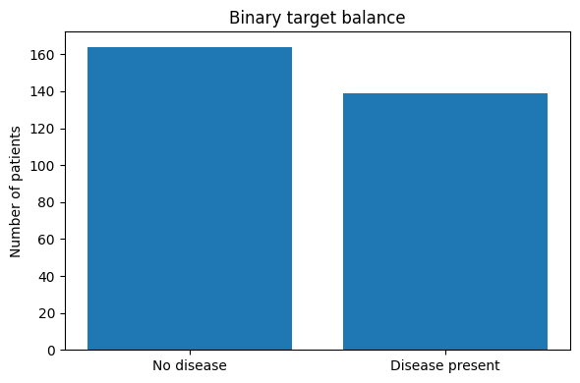
Data collection and pre-processing
Preparation pipeline
Encoded missing values converted to true NaN: ca (4), thal (2) — imputed with training-set mode only (ca=0, thal=3)
Split 242 train / 61 test before imputation and discretisation, so no test information leaks into preprocessing
5 continuous variables (age, trestbps, chol, thalach, oldpeak) cut into Low/Medium/High using training-derived quantiles, applied unchanged to test set
Balanced accuracy, recall, specificity, ROC-AUC and PR-AUC retained alongside accuracy for a fuller evaluation
164 no disease (54.1%) vs 139 disease present (45.9%) — reasonably balanced
Notes:
Table 1 and Section 3.1/3.3 of the report. Stress the ordering: split first, then impute/discretise using training statistics only — this is what prevents leakage.

Slide 3
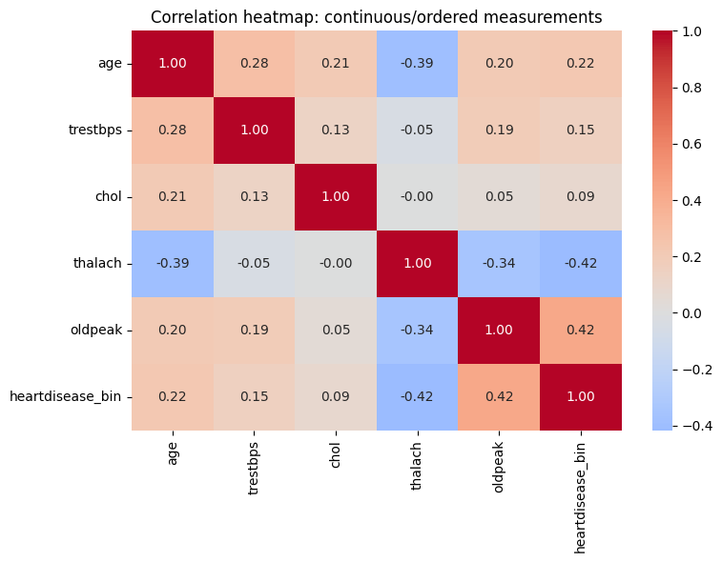
Exploratory analysis: what the raw correlations show
Descriptive, not causal
Strongest pairwise links with the target: oldpeak (r ≈ 0.42) and thalach (r ≈ −0.42)
chol shows almost no linear relationship (r ≈ 0.09)
age and thalach are moderately correlated (r ≈ −0.39), consistent with heart rate declining with age
Pearson shown only for numeric/ordered measurements; nominal codes (cp, thal, restecg) are not treated as continuous here
Notes:
Section 3.2 of the report. This heatmap is explicitly framed as descriptive, feeding into but not pre-empting the structure-learning stage that follows.

Slide 4
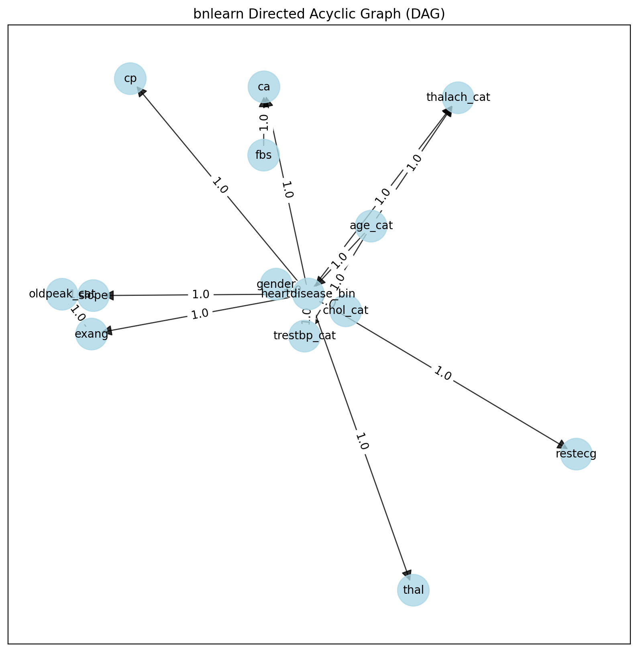
Expert-designed DAG: 16 edges, 3 reasoning pathways
Three pathways
Risk-profile: age, gender, BP, cholesterol → target (only 4 parents, 54 configurations)
Diagnostic-evidence: cp, restecg, exang, ca, thal, slope, thalach as downstream findings
Exercise-response: age, exang, slope, thalach, oldpeak linked through additional edges
Arrows encode the chosen factorisation, not established physiological causality.
Notes:
Section 4.1. Note the figure title in the notebook is the generic bnlearn plotting label but this is the manually specified expert graph.

Slide 5
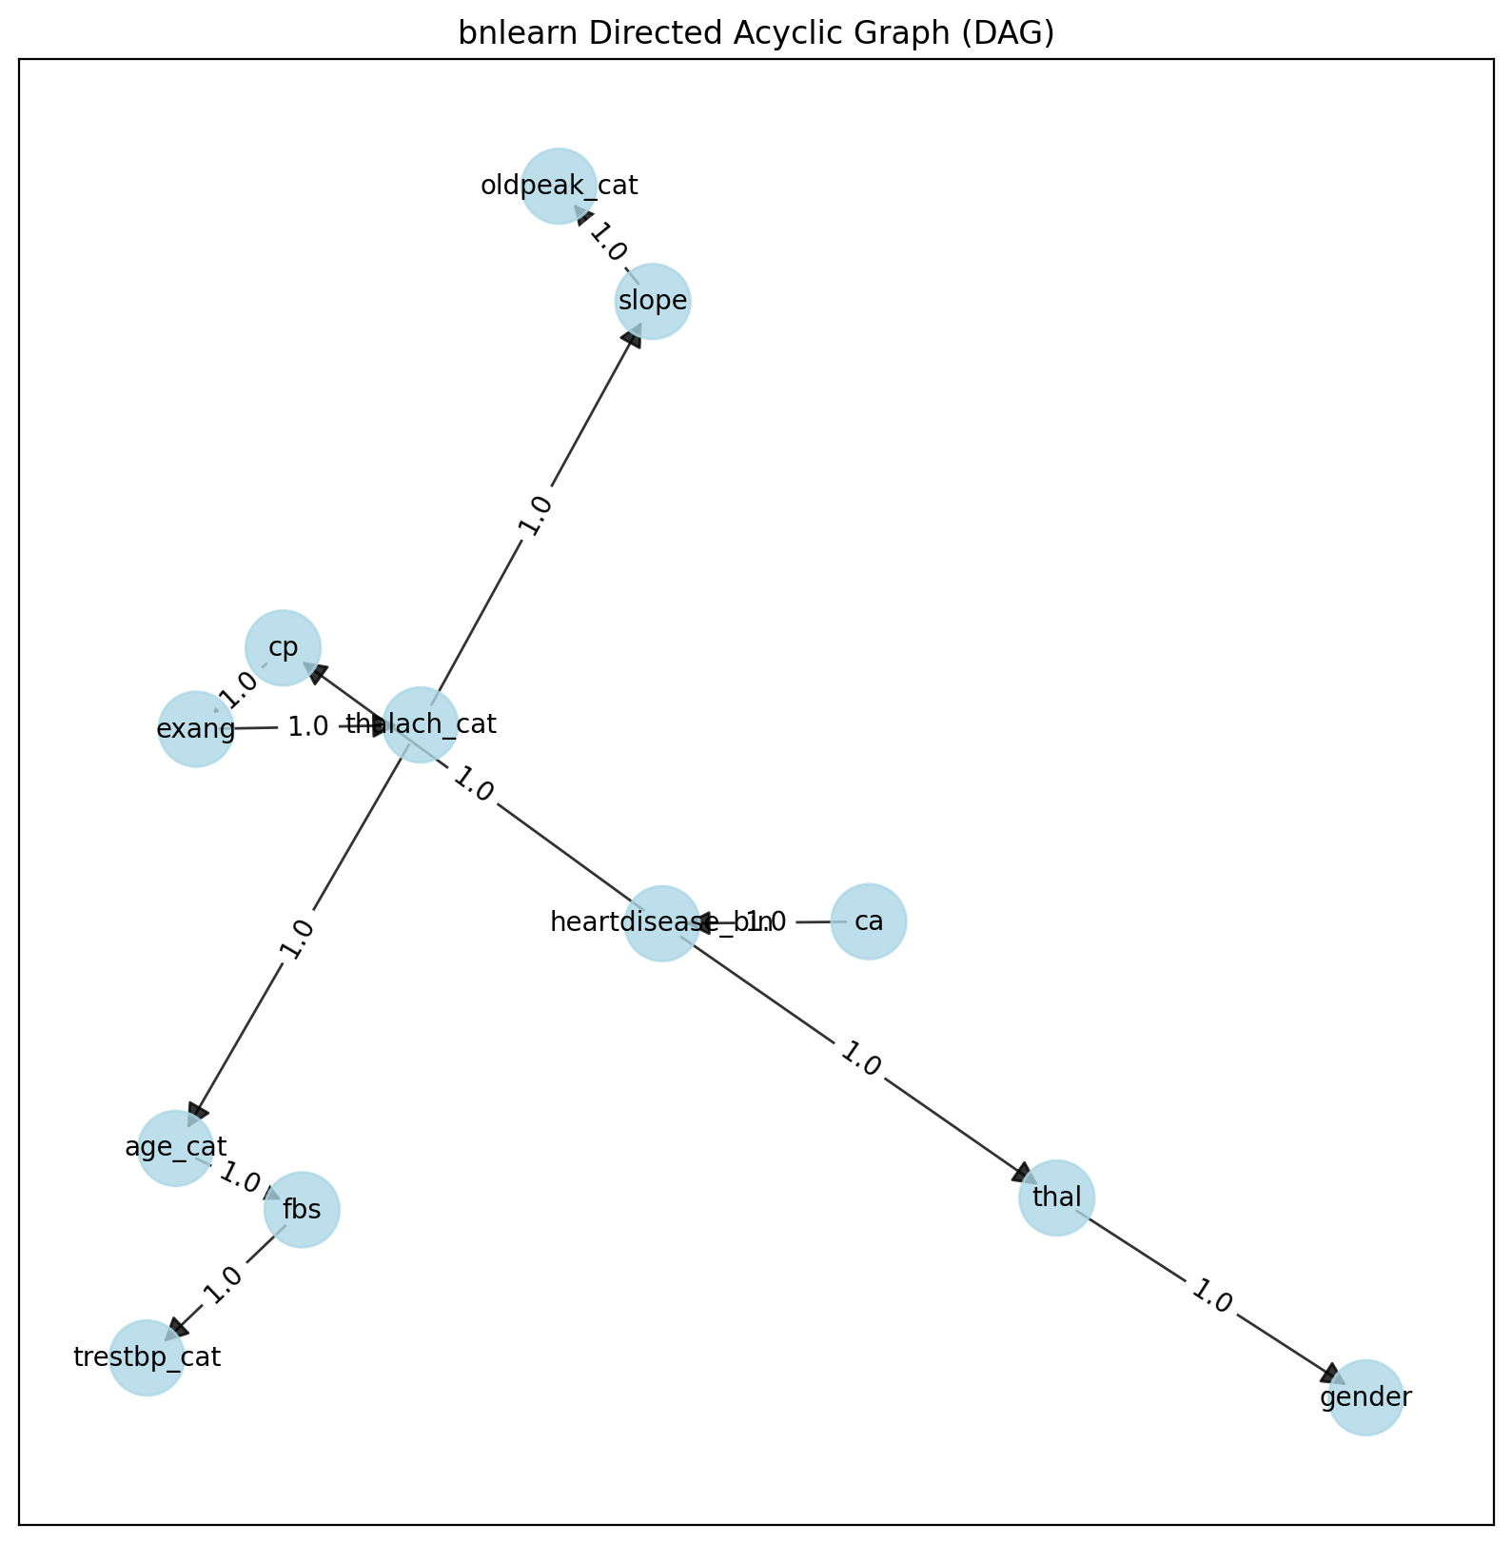
Data-driven DAG: Hill Climbing + BIC, 11 edges
Why HC + BIC
Hill Climbing: local search over edge add/delete/reverse moves
BIC: rewards fit, penalises unnecessary complexity — sparse graph for 242 rows
Target has a single parent, ca, and two children, cp and thal
thal → gender is an empirical dependency, not a plausible causal statement
Notes:
Section 4.2. Reinforce that the learned network is evaluated primarily as a probabilistic/predictive structure, not a causal model.

Slide 6
Structural comparison: partial agreement
3
5
2
16 / 11
common directed edges
shared adjacencies
reversed relationships
expert / learned edges
Comparison | Count | Examples
Common directed edges | 3 | disease→cp; disease→thal; slope→oldpeak_cat
Reversed relationships | 2 | age_cat↔thalach_cat; disease↔ca
Learned-only edges | 8 | age_cat→fbs; fbs→trestbp_cat; cp→exang; thal→gender
Notes:
Table 3 from the report, Section 4.3. The reversed age-heart-rate edge is a good talking point for why observational structure learning should not be read causally.

Slide 7
Parameter learning: expert target CPT
Pattern | Condition | P(disease=1)
Highest configuration | age High, chol High, male, BP High | 0.622
Lowest configuration | age Low, chol Low, female, BP Low | 0.336
Gender swing | female → male, others fixed | 0.402 → 0.622
Age-category swing | Low → Medium, others fixed | 0.425 → 0.613
Cholesterol swing | Medium → High, others fixed | 0.436 → 0.622
Resting-BP swing (non-monotonic) | High → Low in one configuration | 0.436 → 0.622
BDeu smoothing was used (not raw maximum likelihood) because 242 training rows sparsely populate the 54 parent configurations. The BP pattern is not monotonic and is reported as a local CPT result, not a causal blood-pressure effect.
Notes:
Table 4, Section 5.1. Direct-parent marginal CPDs (Table 5) can be mentioned verbally: age_cat, chol_cat roughly uniform across Low/Medium/High (~0.33 each); gender close to even (0.465/0.535); trestbp_cat conditioned on age_cat shows small shifts by age band.

Slide 8
Parameter learning: learned target CPT
ca is the only direct parent of the target in the learned DAG
P(disease | ca=0) = 0.417, rising to 0.531 at ca=1 — the biggest single jump
ca=2 (0.530) and ca=3 (0.519) add almost nothing further
A far simpler CPT than the expert network's 54-configuration table, though inference can still draw on the broader learned graph
Notes:
Section 5.3. Good bridge into the inference section: the single-parent CPT is easy to estimate but the network still uses cp and thal as children during inference.

Slide 9
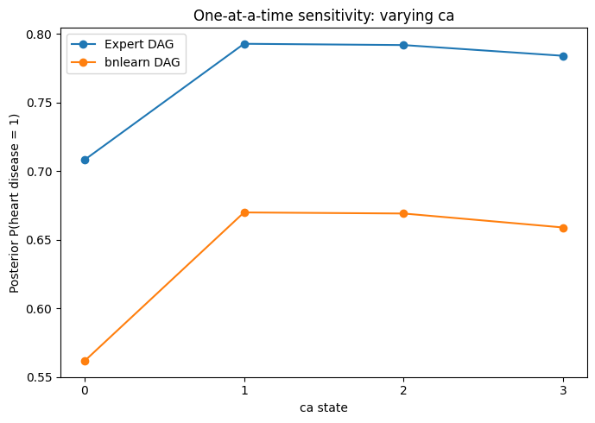
Inference: riskiest profiles and one-variable sensitivity
Statistic | Expert DAG | bnlearn DAG
Maximum posterior | 0.793 | 0.670
Minimum posterior | 0.192 | 0.307
Posterior range | 0.601 | 0.363
Mean abs. posterior diff. | 0.0564
Spearman rank correlation | 0.7664
Highest-ranked profiles in both networks repeatedly include gender=1, cp=4, thal=7, ca=1.
Notes:
Section 6.1 and 6.2. The largest shift for both networks occurs from ca=0 to ca=1 (expert +0.085, learned +0.109); further vessels add little.

Slide 10
Reverse inference: given disease = 1
cp: type 4 (asymptomatic) has the largest posterior among chest-pain states in both networks, ≈0.340
thal: reversible defect (thal=7) has the largest posterior among thal states in both networks, ≈0.394
exang: expert network places slightly more mass on exang=1 (0.507); learned network places slightly more on exang=0 (0.530)
ca: state 0 has the largest single posterior (≈0.272) but probability stays spread across all four states
These results show which explanatory states become more probable once disease is fixed as present — they do not imply those states independently cause disease
Notes:
Section 6.3. This directly answers the assignment's reverse-inference requirement: posterior of explanatory variables given heartdisease_bin = 1.

Slide 11
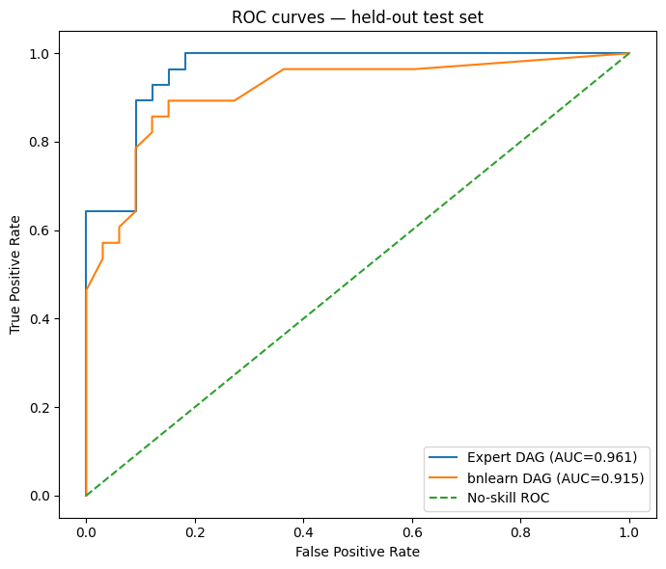
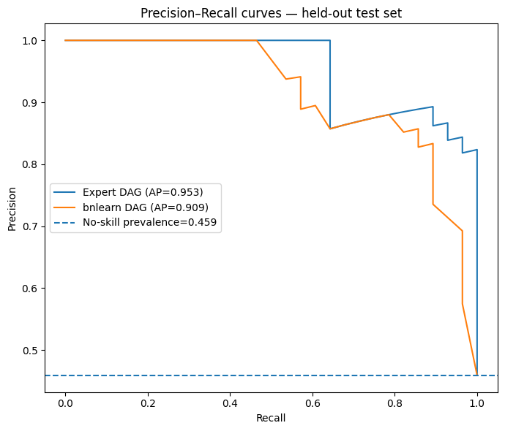
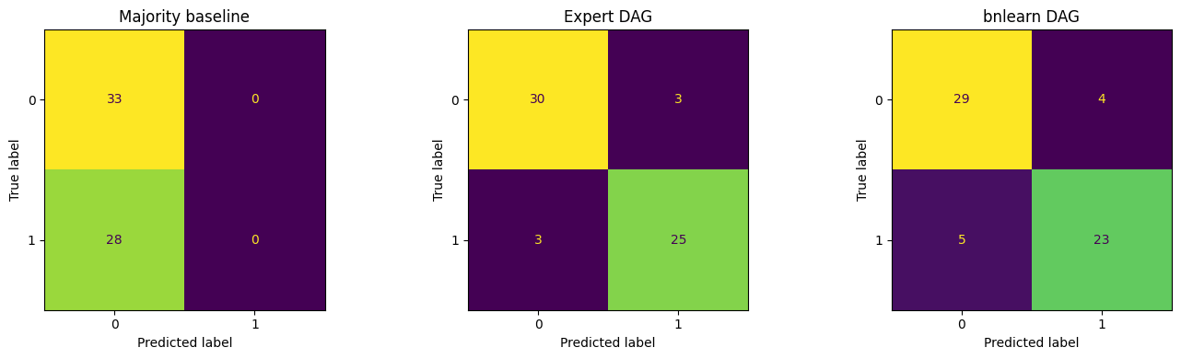
Model evaluation: held-out test set (n=61)
Model | Accuracy | Bal. Acc. | Precision | Recall | Spec. | F1 | ROC-AUC | PR-AUC
Majority baseline | 0.541 | 0.500 | 0.000 | 0.000 | 1.000 | 0.000 | 0.500 | 0.459
Expert DAG | 0.902 | 0.901 | 0.893 | 0.893 | 0.909 | 0.893 | 0.961 | 0.953
bnlearn DAG | 0.853 | 0.850 | 0.852 | 0.821 | 0.879 | 0.836 | 0.915 | 0.909
Expert: 30 TN, 25 TP, 3 FP, 3 FN. bnlearn: 29 TN, 23 TP, 4 FP, 5 FN. Majority: 33 TN, 0 TP, misses all 28 positives.
Notes:
Table 7 and Figures 7/8 of the report. Both networks clearly beat the no-skill baseline; the expert DAG leads on every single metric.

Slide 12
Executive summary
303
242 / 61
5,184
0.056
patients, 13 predictors
train / test split
evidence profiles scored
mean posterior gap
Two discrete Bayesian networks built on the Cleveland dataset: an expert-designed DAG and a data-driven DAG learned with Hill Climbing + BIC
Expert DAG: 16 edges, 4 target parents. Learned DAG: 11 edges, 1 target parent (ca)
On the 61-patient held-out set, expert DAG reached F1 = 0.893, ROC-AUC = 0.961, vs 0.836 and 0.915 for the learned DAG
Both networks agree closely on which evidence is riskiest (cp=4, thal=7, ca=1), Spearman rank correlation 0.766
Recommendation: retain the expert DAG as the preferred model for this dataset and split, but treat edges as probabilistic dependencies, not proven causal effects
Notes:
This mirrors the report's Executive Summary section verbatim in substance. Emphasise the closing caveat: results are evidence for this dataset and split, not a clinically validated system.

Slide 13
Conclusion, limitations and recommendations
Conclusion
Limitations
Recommendations
Expert DAG preferred: strongest held-out metrics (F1 0.893, AUC 0.961) plus explicit, organised justification
Not proof the expert structure is causal or clinically deployable — evidence for this dataset and split only
Small sample (303) and test set (61); results are split-sensitive
3-state discretisation sacrifices within-bin detail
Simple mode imputation for ca/thal
HC+BIC can settle on a locally preferred, score-equivalent structure
Calibration not formally assessed
Cross-validation / bootstrap to quantify uncertainty
Assess posterior calibration alongside AUC
Clinical review of expert edges before causal use
Test alternative discretisation and BDeu priors
Compare against further transparent baselines
External validation before any operational use
Notes:
Sections 8, 9 and 10 of the report. Close by restating the research question and answering it directly: the expert DAG offers the more favourable combination of predictive performance and interpretability in this dataset, with the learned DAG serving as a valuable empirical benchmark.

